Slide 1
Scalars and Vectors

Slide 2
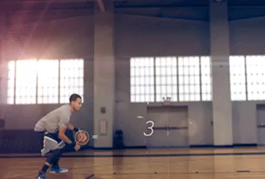
In this Smart lesson you will learn to:
Define the terms vector and scalar.
Use the terms vector and scalar to categorise physical quantitites.
Calculate resultant vectors through the addition of two vectors.

Slide 3

So what do the terms vector and scalar mean?
Scalar is defined as a quantity that has a magnitude but no direction.
Vector is defined as a quantity that has both magnitude and direction.
For example the ball below moves a distance of 2 m which is a scalar value, but if you said it moves 2 m to the left, that is displacement and is a vector as it has direction.

Slide 4
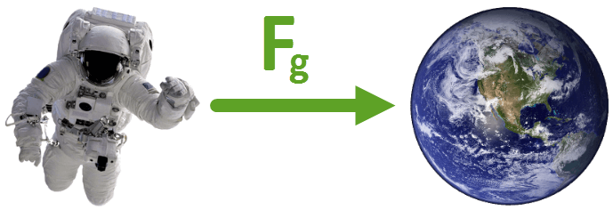
Examples of scalars and vectors.
Distance is a scalar, which means it's described by a size only. Other examples of scalars are temperature, speed and mass. None of these quantities have a direction.
Displacement is a vector, which means it's described by a size and direction. Another example of a vector is the acceleration due to the force of gravity, as it has a size (9.8 ms⁻²) and direction (toward the centre of the Earth). Velocity is also a vector quantity.
Both distance and displacement are measured in metres (m).

Slide 5

We use symbols to help distinguish a vector quantity.
A vector may be represented pictorially by an arrowed line segment (→) and symbolically as or a​.
The arrow helps remind us that a vector includes direction.

Slide 6
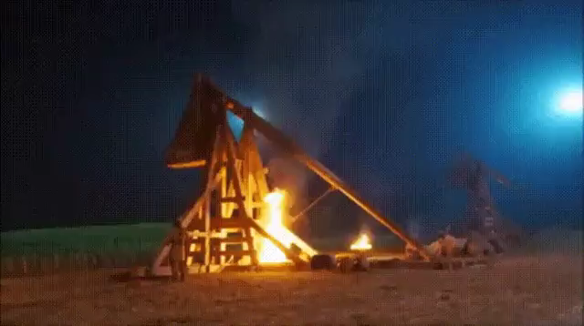
We are going to learn about scalars and vectors in the context of a trebuchet.
A trebuchet is a weapon of war that uses a swinging arm to throw a projectile, as demonstrated in this video:

Slide 7
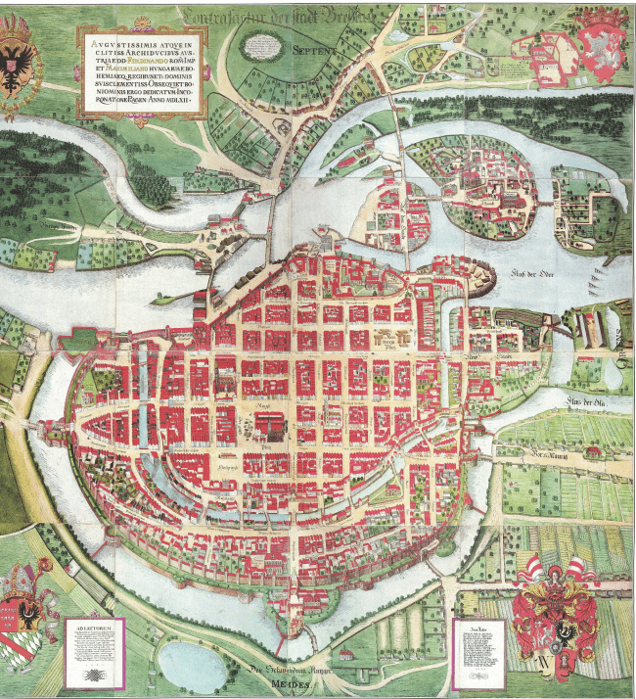
We will be exploring the Polish city of Wroclaw (read: vrot-swaf).

Slide 8
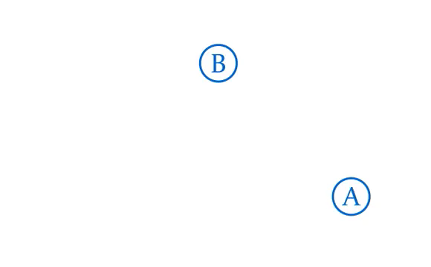
Imagine you want to get from point A to point B.
Getting from A to B is impossible if you don't know the distance from A to B.
The distance from A to B is 300 m.

Slide 9
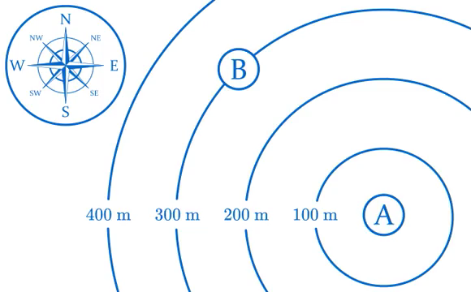
But distance isn't enough! You also need to know the direction from A to B.
To describe the distance AND direction between two points we use a quantity called displacement.
Direction can be recorded using a compass rose. Imagine a line from A to B, and pick the line in the compass rose that points in the same direction.
The direction from A to B is northwest (NW).

Slide 10
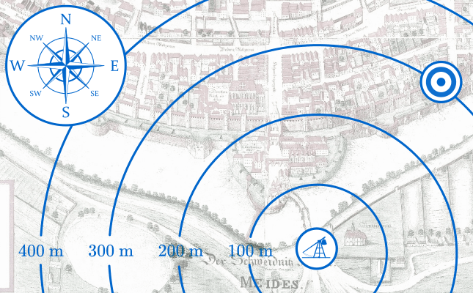
Example:
Your trebuchet is all set up on the riverbank, ready to fire at the city wall. To fire a trebuchet accurately, the distance and direction to your target must be known.
What is the displacement of the target below?

Slide 11
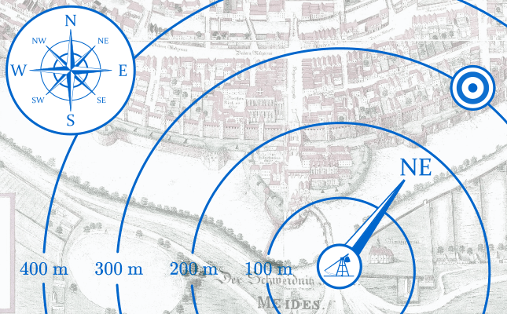
Solution:
The line on the compass rose that points in the same direction as the target is the northeast line.
The target is 300 m northeast.

Slide 12
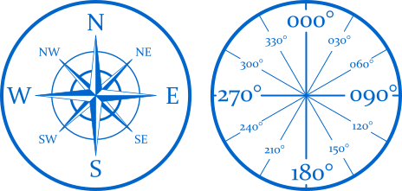
Compass points aren't very accurate.
However, we can measure a direction as a bearing.
Bearings are angles in degrees from 000° to 359°, and are measured clockwise from north.

Slide 13
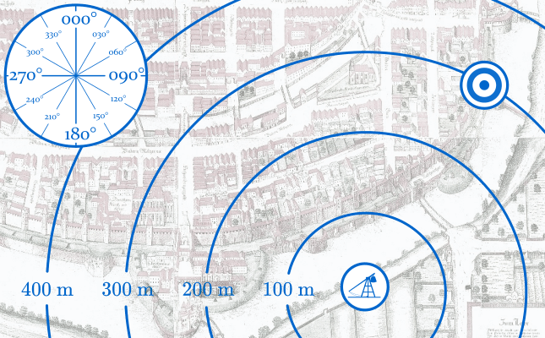
Example
What is the bearing from the trebuchet to the target below?

Slide 14
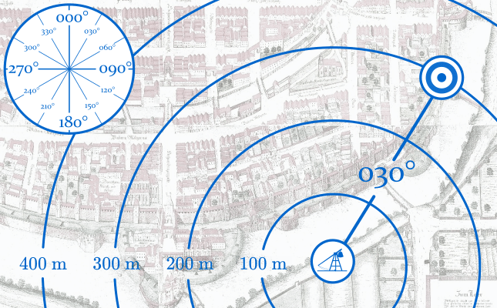
Solution
Looking at the protractor, we can see that the angle from north is approximately 030°.
Therefore, the bearing of the target below is 030°.

Slide 15
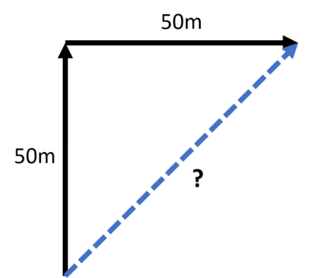
How do we add together scalar quantities?
For example, if I walk 50 m then walk another 50 m, how far have I walked?
In this case, it is simply the sum of the two values.
50+50=100 m
But what if I want to consider direction as well?
If I walk 50 m north, then 50 m east, how far from the starting point am I?

Slide 16
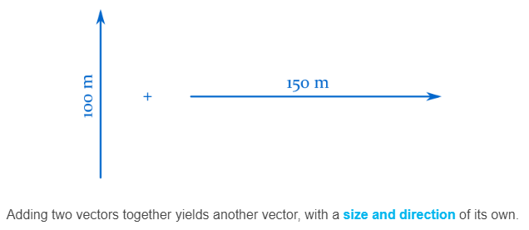
In this section we'll learn how to add vectors together.

Slide 17
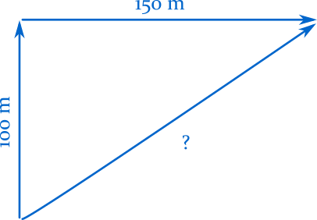
Vectors are added by connecting the arrowhead of one vector to the tail of a second vector.
The sum of the two vectors is the distance and direction from the tail of the first, to the tip of the second:

Slide 18
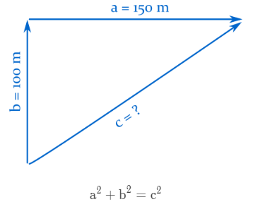
We calculate the size of the new vector with the Pythagorean theorem:

Slide 19
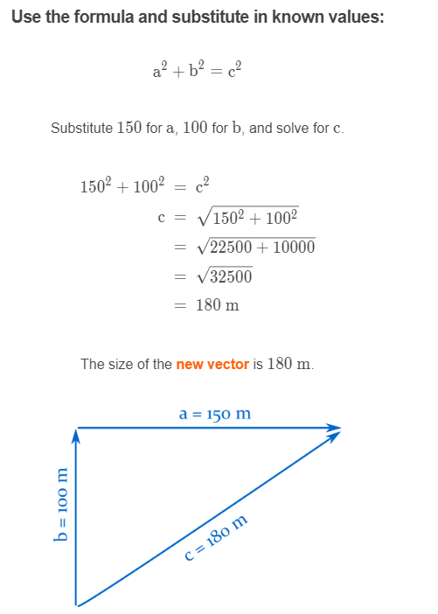

Slide 20
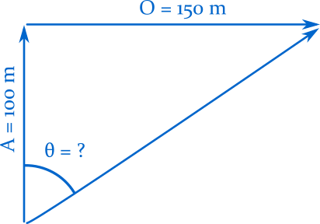

What about the direction from the start?
To work out the direction of the new vector we use trigonometry to calculate the angle (θ) inside the triangle:
In this case we'll use the tangent function, as we know the opposite (O) and adjacent (A) sides, and want to find the angle:

Slide 21
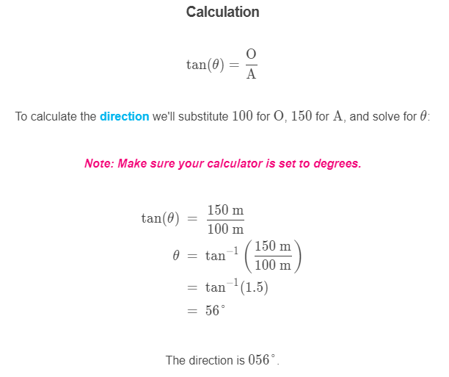
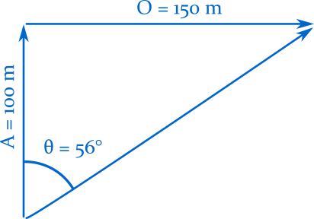

Slide 22
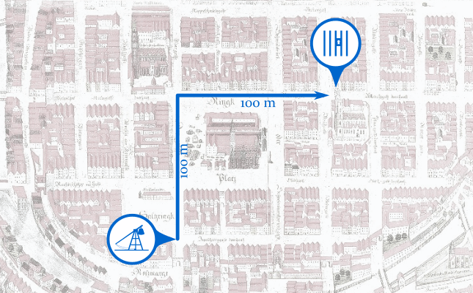
Example
One of your trebuchets has destroyed the south gate, and advanced into the city. A local has provided you with directions to a jail, where several of your soldiers are imprisoned:
"To get to the jail, walk 100 m north, then 100 m east."
Instead of walking over to explain the situation, let’s fire the trebuchet at the jail to break them out.
What is the distance from the trebuchet to the jail?

Slide 23
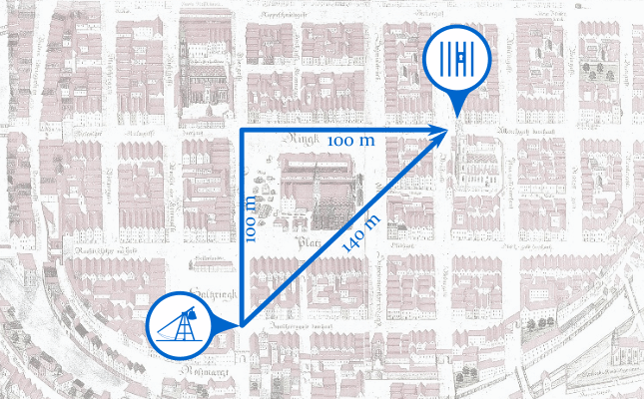
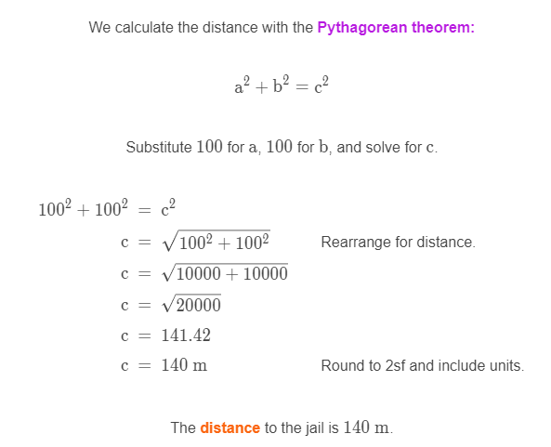

Slide 24
Example
The distance from the trebuchet to the jail is 140 m.
What is the direction from the trebuchet to the jail?

Slide 25
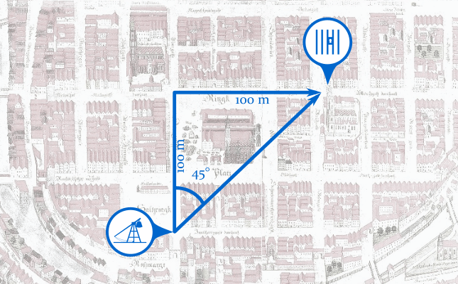
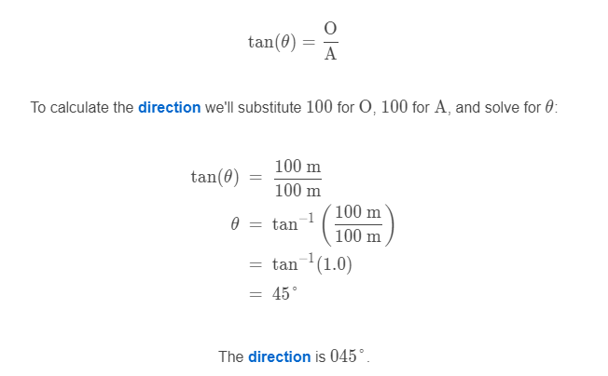
To calculate the direction to the jail we’ll use trigonometry to calculate the angle inside the triangle.
In this case we'll use the tangent function, as we know the opposite and adjacent sides, and want to find the angle:

